Slide 1
Foundations of Computer Security

Slide 2
Summary
1960's, 1970's, 1980's: Security is a DoD problem
only ones who really care
only ones who have budget for custom solutions
1990's: Security is _______ Problem
DoD, stock market, Internet, e-commerce, privacy, liability….
Huge wins for quick-to-market solutions
Not the right approach
Everyone's

Slide 3
Question
B. Journey
Computer Security is a ____.
Destination
Journey

Slide 4
Question
D.
Computer security is a concoction of ____.
science
Science and technology
science, technology and engineering
science, technology, engineering, and human factors

Slide 5

Objectives
Approach a definition of computer security: CIA and more
Explain the fundamental dilemma of computer security
Mention some general security principles

Slide 6
Definitions
All of the following are security issues ?
Software crash, breakdown of communications, hardware component failures, mistakes made by human operators
Reliability issues |  | Operating mistakes
Usability issues |  | Intentional failures
Security issues |  | Accidental failures
Computer systems
Standalone boxes with processors and memory
Networks of standalone boxes

Slide 7

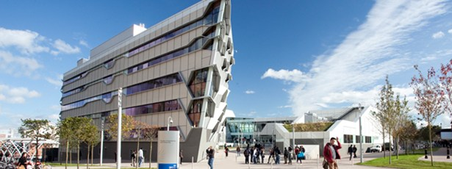
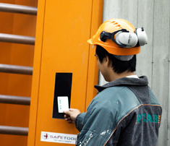
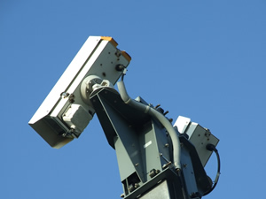
Definitions
Security
About the protection of ______
Protection measures
Prevention
Detection
When, how, who
Reaction
Recovery
assets
e.g. Locks at the door/window bars
e.g. Burglar alarm, CCTY cameras
e.g. Calling police, replacing the stolen item

Slide 8

Computer Security Principles
Which kind of protection measures do they belong to?
A
A: Prevention
B: Detection
C: Reaction
CIA
?
Triad
Prevention of unauthorized _________ of information or resources
withholding
Prevention of unauthorized __________ of information
modification
A: withholding
B: modification
C: disclosure
Prevention of unauthorized _________ of information
disclosure

Slide 9
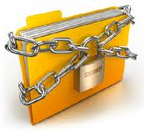
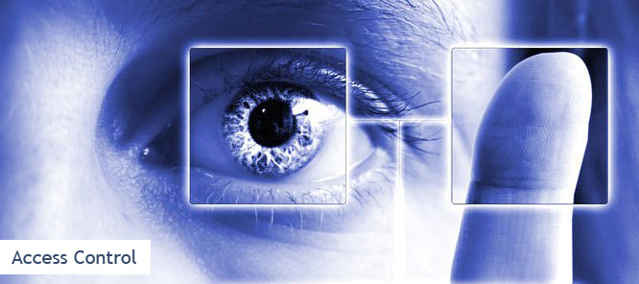
Discussion
Is cryptography the only measure that enforces confidentiality?
Others such as
authentication & access control
will discuss them later

Slide 10
Discussion
Why triad?
It’s possible to ensure CIA of data equally.
An organization may choose to prioritize the importance of one or two of these
Based on the goals of the organization/systems
Based on the budget
Never gonna have all three things at perfect level
Confidentiality ⬄ Availability
Public Blockchain: Integrity&Avaiability ⬄ Privacy

Slide 11
Other CS Principles
Authenticity
Identification of a user’s identity
Authorization
Grant/deny a user access to computer resources
after the user has been authenticated
based on user’s privileges or permissions
Accountability
Tracing actions affecting security to the responsible party
via an audit trail of security-relevant events
Debian and Ubuntu: /var/log/auth.log
Non-repudiation
Provision of unforgeable evidence that a specific action occurred
…
More details later

Slide 12
Question
Match the categories of the ways to protect information asset (on the left) with existing technologies on the right.

Slide 13
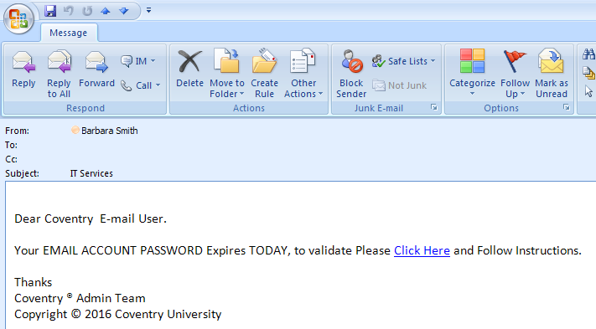
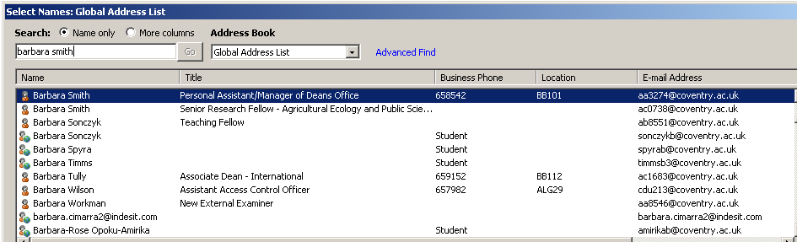

Slide 14
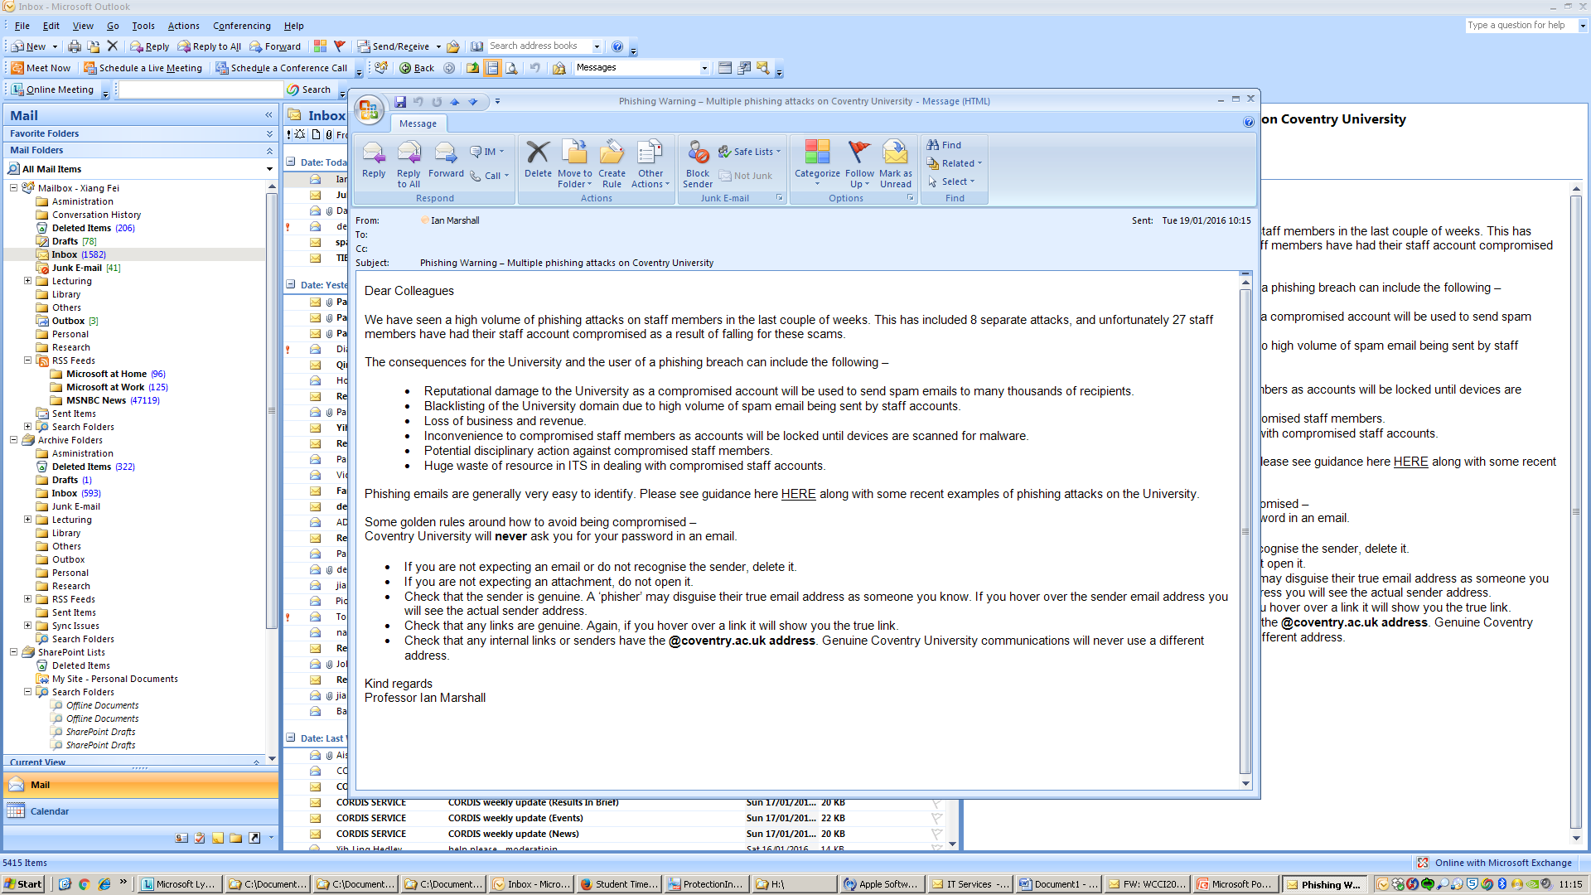

Slide 15

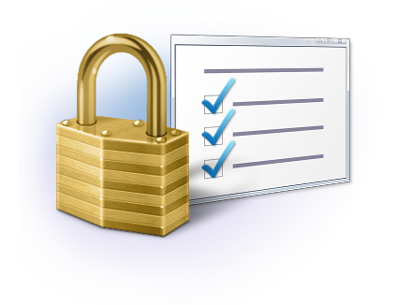
Dilemma of Computer Security
Who are the users of CS?
Security-unaware
Having specific security requirements
Usually no security expertise
Security mechanisms => additional computational resources
Security => changing the working patterns users are accustomed to
Security mechanisms => new vulnerabilities
Impact of CS on the computer system?

Slide 16
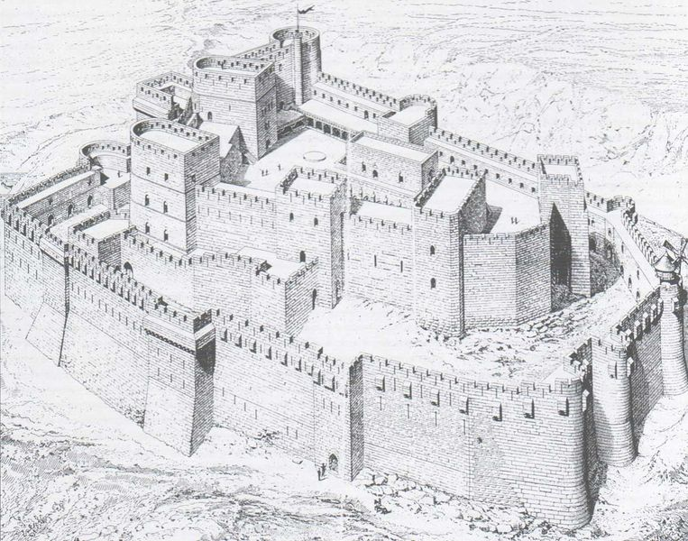
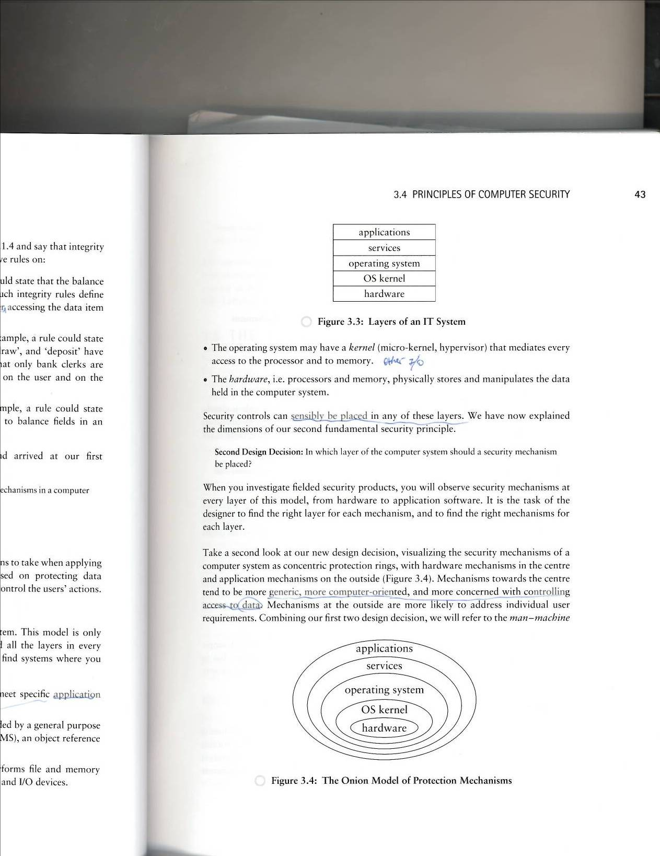
Further Computer Security Principles
Defense in Depth
implementing several layers of protection

Slide 17
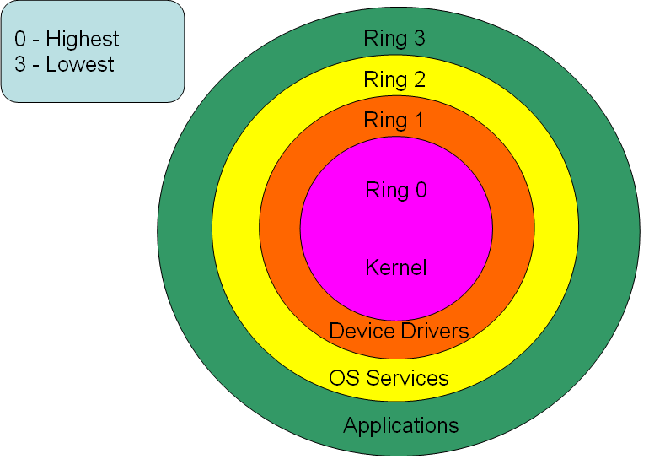
Further CS Principles: Layered Security
Every protection mechanism defines a security perimeter (boundary)
Outside the boundary:
Will breaking parts outside the boundary have effect on the protection mechanism?
Inside the boundary:
Will breaking parts inside the boundary have effect on the protection mechanism?
parts inside the boundary can be used to disable the protection mechanism;
An attacker with access to the layer below is in a position to subvert protection mechanisms further up.
No
Yes
http://itoperationswiki.blogspot.com/2013/12/protection-rings-and-types-of.html

Slide 18
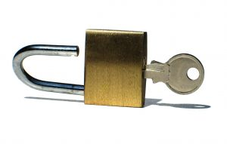
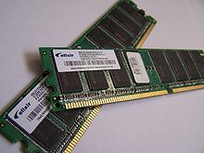
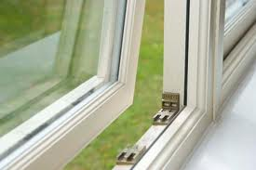
The Layer Below: Examples
If you gain systems privileges in the OS,
Able to change programs/files containing the control data for security mechanisms in the services and applications layer
If you have direct access to the physical memory devices
Can manipulate the raw data => bypassing the access controls of the OS
http://itoperationswiki.blogspot.com/2013/12/protection-rings-and-types-of.html

Slide 19
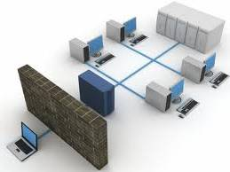
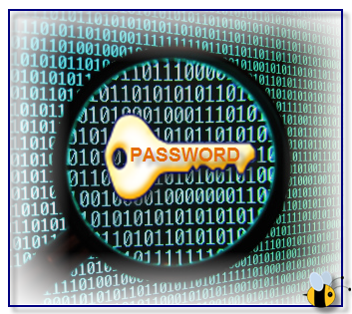
The Layer Above
Can infrastructure defend against attacks from the layer above?
E.g. cracking iCloud users’ passwords
An application may take care of its own security requirements
Fundamental Fallacy of Computer Security:
Don’t believe that you must secure the infrastructure to protect your applications.

Slide 20

Summary
In this lecture you have learned about:
Definition of computer security
CIA, Authenticity, Authorization, Accountability, Non-Repudiation
Prevention, Detection, Reaction
Fundamental dilemma of computer security
Further CS princiles
Defense in Depth, Layered Security
Computer security mechanisms have to rely on physical or organizational protection measures to be effective
The root cause of security problems is _________
human nature

Slide 21
References
Gollman Dieter. (2011) Computer Security, John Wiley and Sons
Darril Gibson. CompTIA Security+: Get Certified Get Ahead: SY0-501 Study Guide

